Slide 1
Four tank system

Slide 2
Members
Full name | Student number
Forough Afkhami | 9823006
Reyhaneh Ahani | 9823009
Fatemeh Rafiee | 9823039
Samira Saljoghi | 9823048

Slide 3
Phase 1

Slide 4
Index
System introduction
Nonlinear model
Linearization and steady state
Block diagonal representation
Transfer function , Poles & zeros
Response
No Stimulation for output frequencies
Linear valid range
Controllability & Observability
Kalman decomposition

Slide 5
1- System introduction
The four-tank system (FTS) is a conventional control system that operates non-linearly and has a delay.
In industrial processes, controlling the liquid level in tanks and the flow between them is a fundamental problem.
The main issue is controlling Liquid level and flow regulation between tanks.

Slide 6
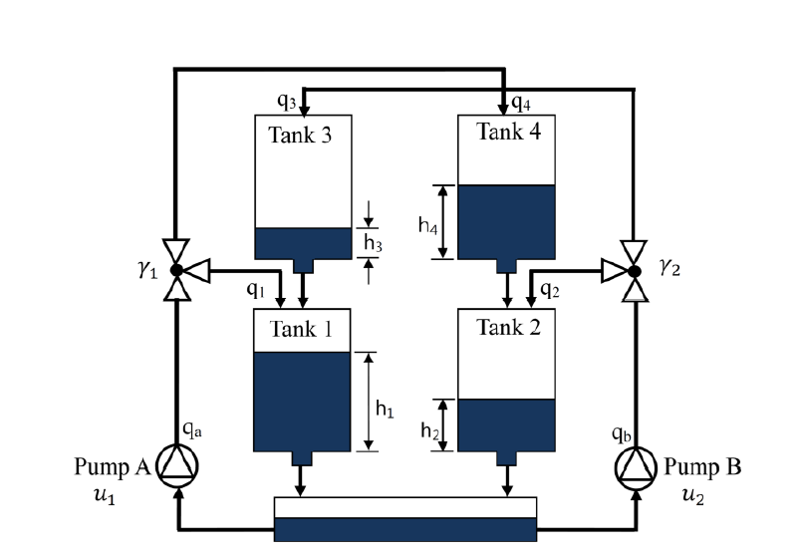
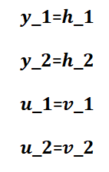
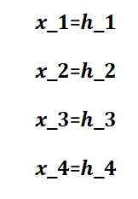

Slide 7
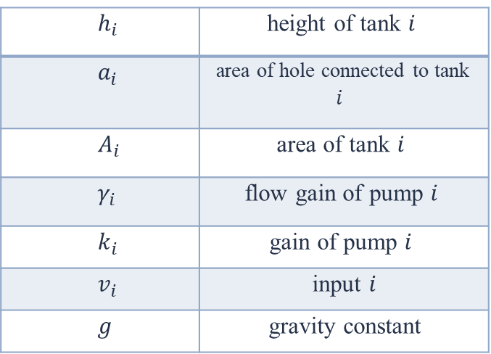
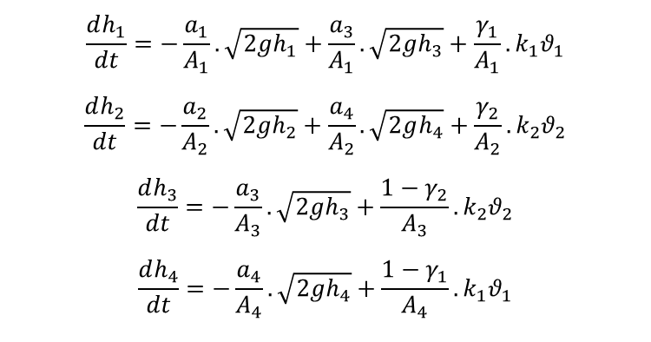
2- Nonlinear model
height of tank $i$ | $$h_{i}$$
area of hole connected to tank $i$ | $$a_{i}$$
area of tank $i$ | $$A_{i}$$
flow gain of pump $i$ | $$γ_{i}$$
gain of pump $i$ | $$k_{i}$$
input $i$ | $$v_{i}$$
gravity constant | $$g$$
$$\frac{dh_{1}}{dt}=−\frac{a_{1}}{A_{1}}.\sqrt{2gh_{1}}+\frac{a_{3}}{A_{1}}.\sqrt{2gh_{3}}+\frac{γ_{1}}{A_{1}}.k_{1}θ_{1}$$
$$\frac{dh_{2}}{dt}=−\frac{a_{2}}{A_{2}}.\sqrt{2gh_{2}}+\frac{a_{4}}{A_{2}}.\sqrt{2gh_{4}}+\frac{γ_{2}}{A_{2}}.k_{2}θ_{2}$$
$$\frac{dh_{3}}{dt}=−\frac{a_{3}}{A_{3}}.\sqrt{2gh_{3}}+\frac{1−γ_{2}}{A_{3}}.k_{2}θ_{2}$$
$$\frac{dh_{4}}{dt}=−\frac{a_{4}}{A_{4}}.\sqrt{2gh_{4}}+\frac{1−γ_{1}}{A_{4}}.k_{1}θ_{1}$$

Slide 8
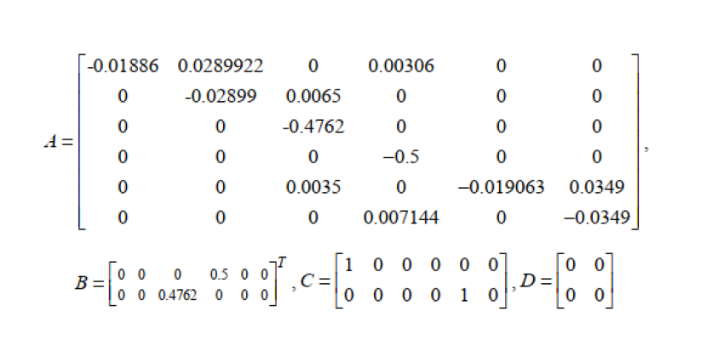
3- Linearization and steady state

Slide 9
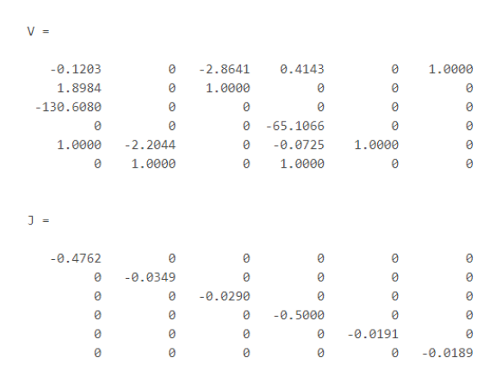
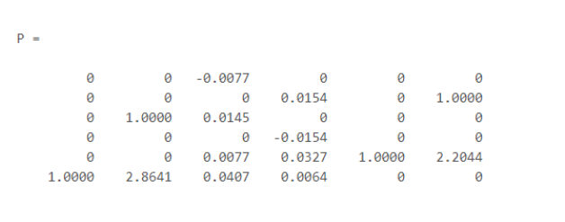
4- Block diagonal representation

Slide 10
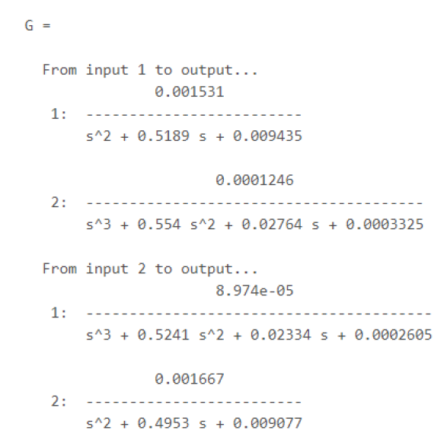
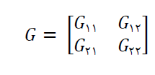
5- Transfer function, Poles & Zeros

Slide 11

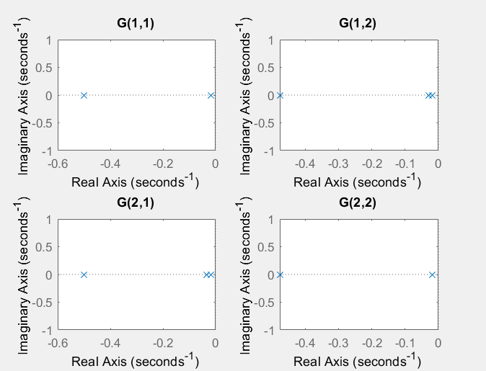

Slide 12

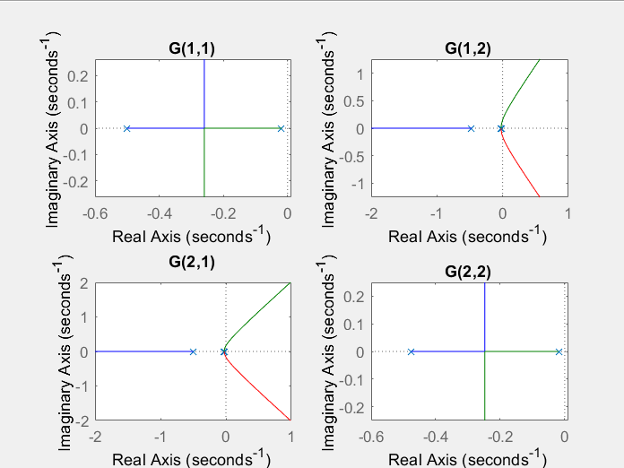

Slide 13
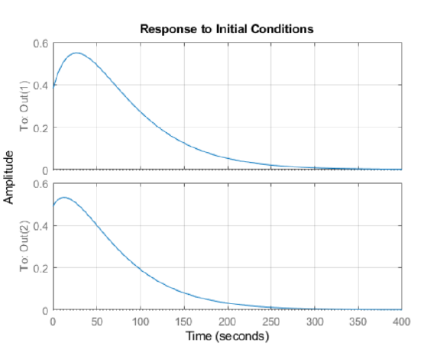
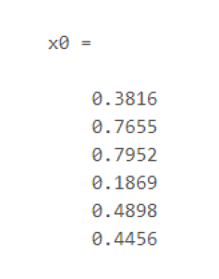
6- Response
Random initial conditions

Slide 14
Random initial conditions

Slide 15
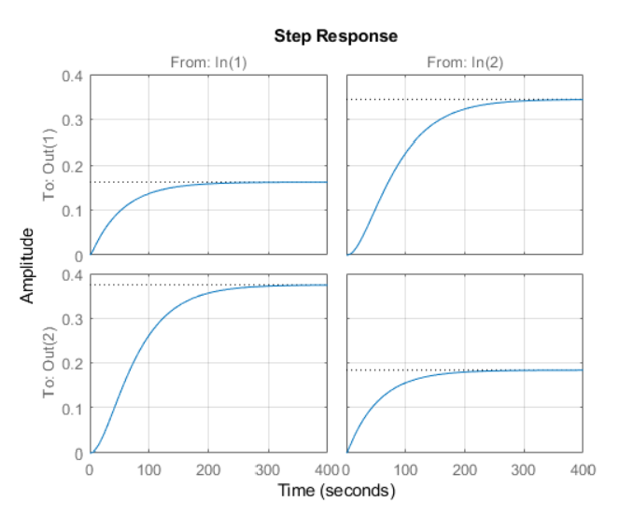

Slide 16
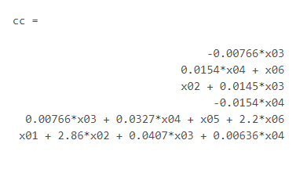
7- No Stimulation for output frequencies
For example : if we want first mode not to be stimulated we should set x03 to zero.

Slide 17
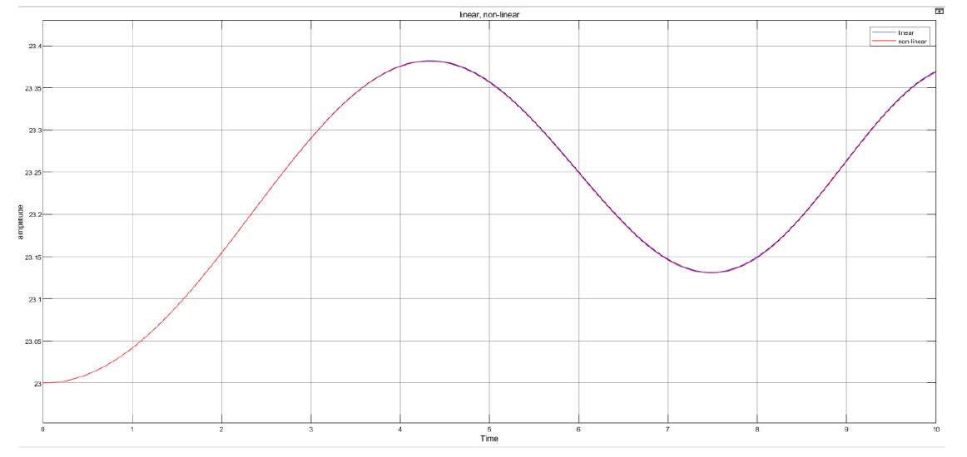
8- Linear valid range
8- gSignal chirp input

Slide 18
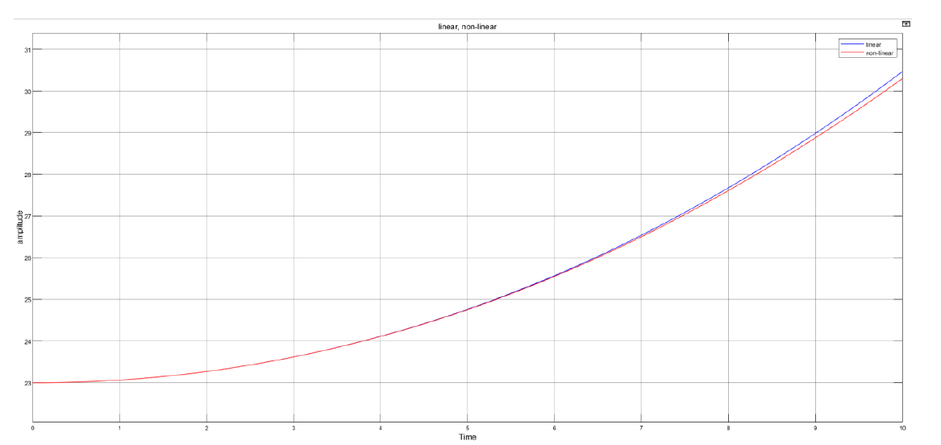
8- Linear valid range
Ramp input

Slide 19
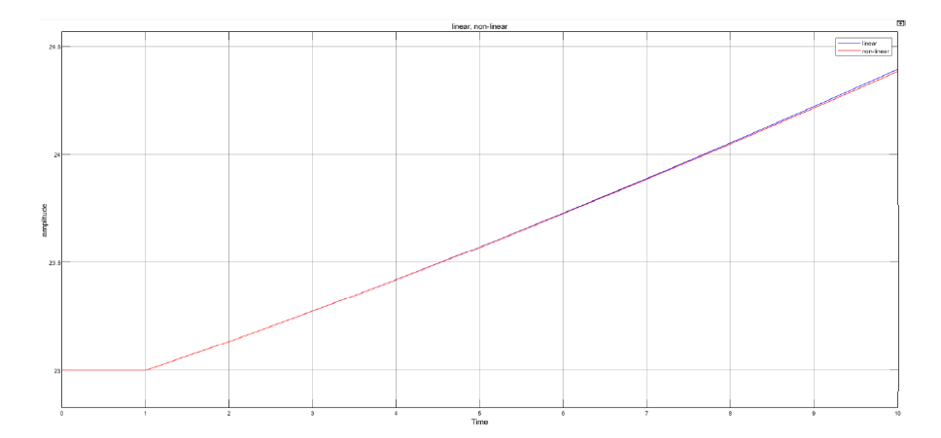
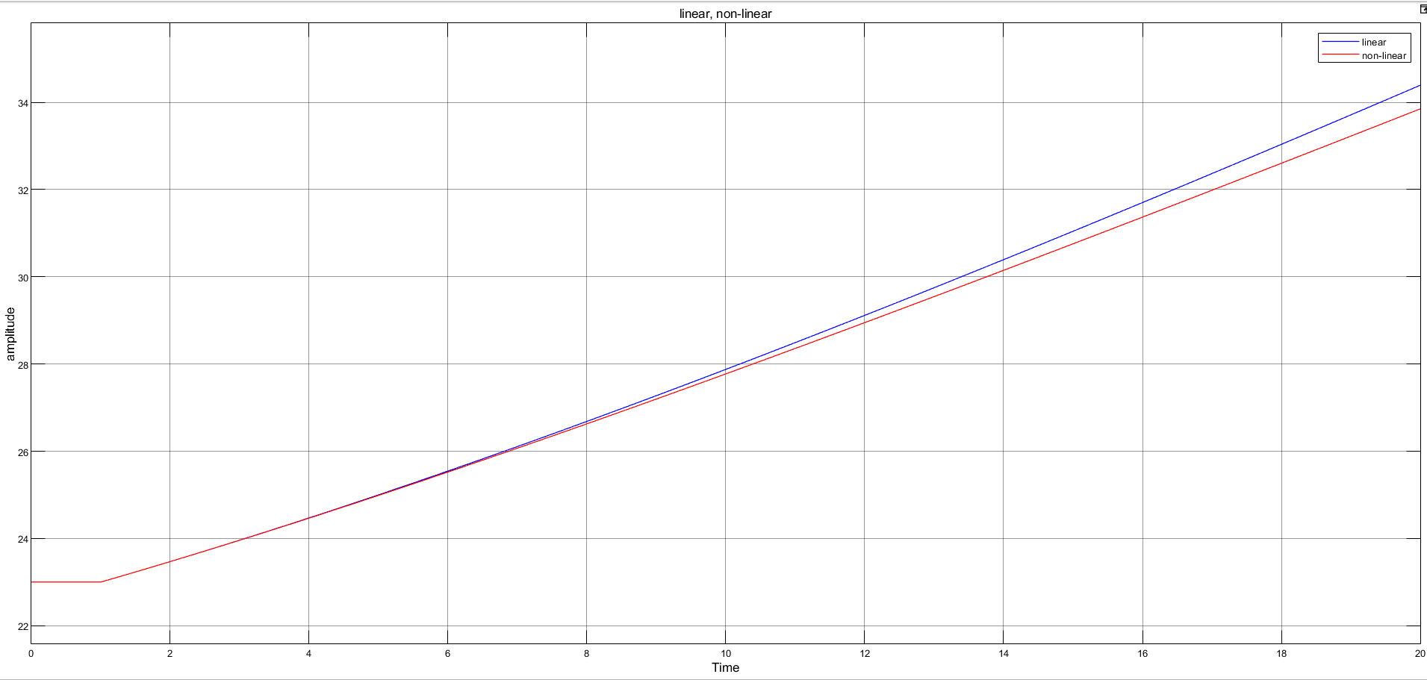
8- linear valid range
Input: u(t)
Input: 3.05u(t)
Step input

Slide 20
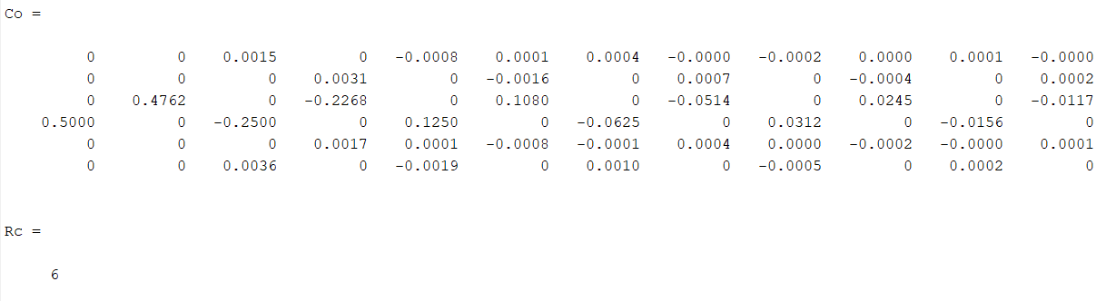
9- Controllability & Observability

Slide 21
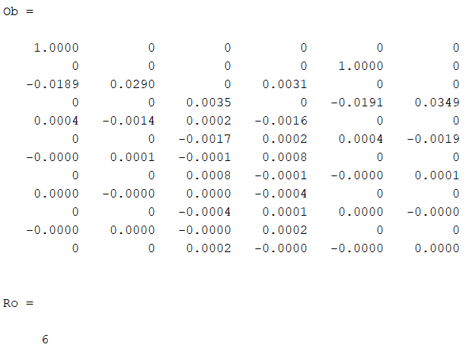

Slide 22
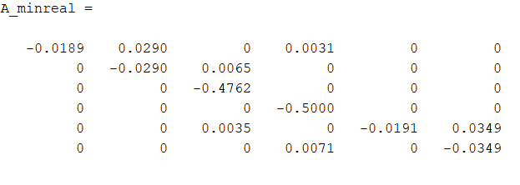
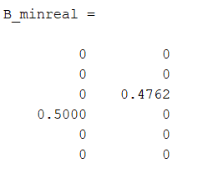
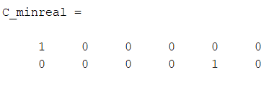
9- Kalman decomposition

Slide 23
Phase 2

Slide 24
Index
Minimal subsystem
State feedback controller
Criterias for designing state feedback controller
Simulation of linear system with state feed back controller
Simulation of non-linear system with state feed back controller
Unstability of nonlinear system with state feedback
Static pre-compensator
Dynamic pre-compensator
Simulation of pre-compensator tracking sine signal

Slide 25
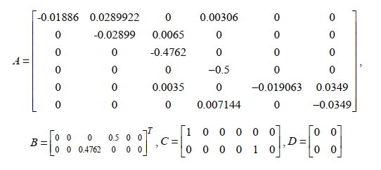
1- Minimal subsystem
We have no uncontrollable and unobservable states.

Slide 26
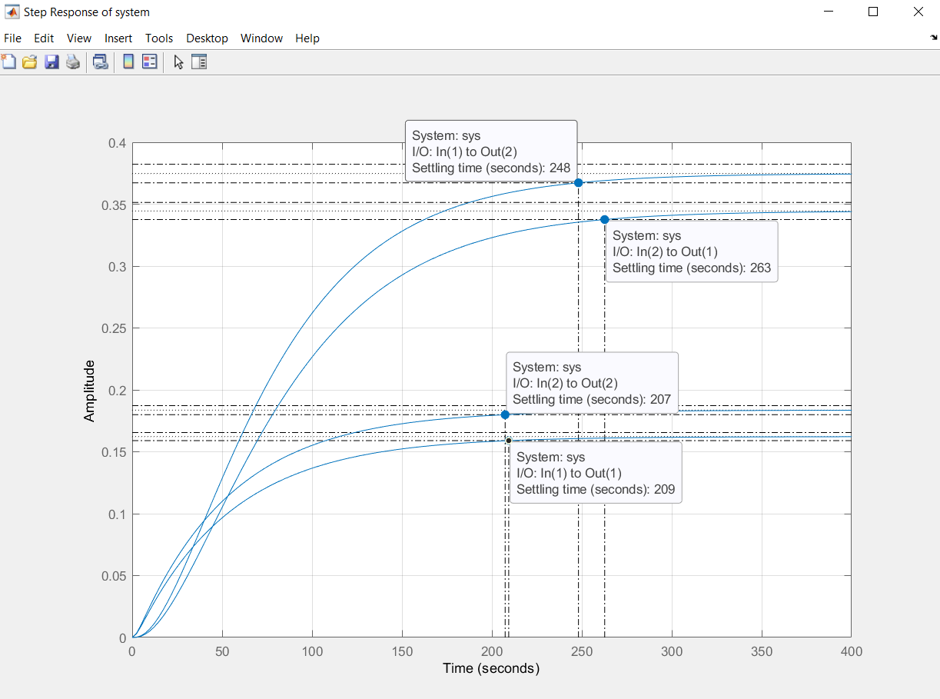
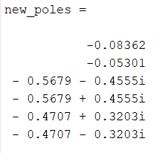

2- Criteria for designing state feedback controller
Chosen criteria for designing:
$$\left\{\begin{aligned}&T_{s,new}= \frac{4}{ξω_{n}}=60 \\ &OverShoot= e^{\frac{−ξπ}{\sqrt{1−ξ^{2}}}}=0\end{aligned}\right.$$
Step response

Slide 27
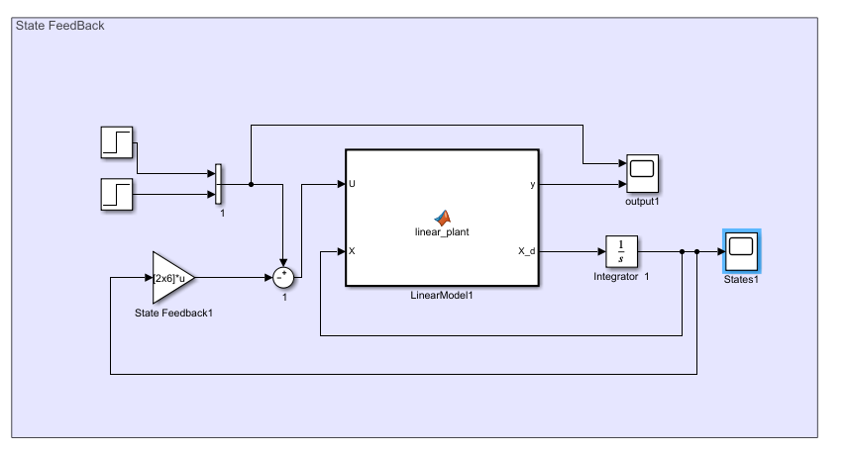
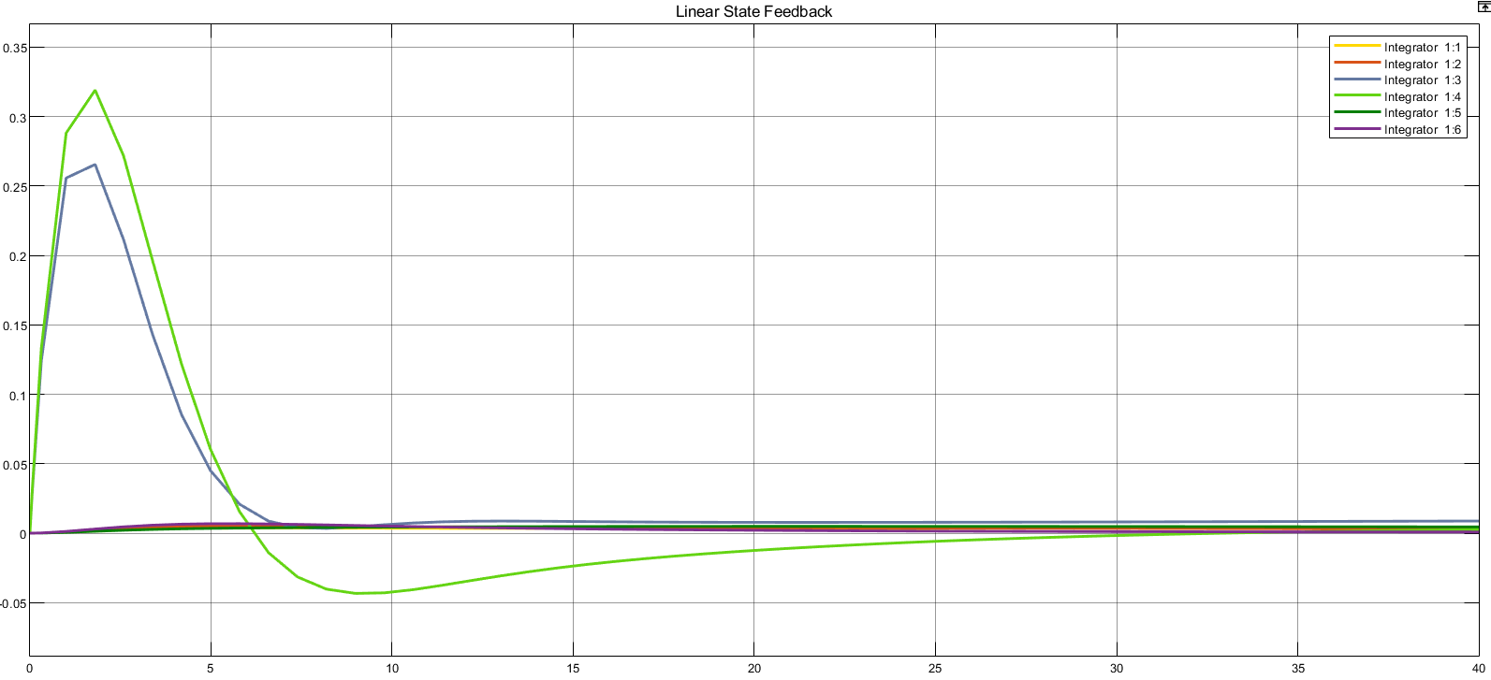
3- Simulation of linear system with state feed back controller
The state diagram of the system with step input and zero initial conditions will converge to zero, which is desirable and the system will provide the desired result in addition to maintaining its stability.

Slide 28
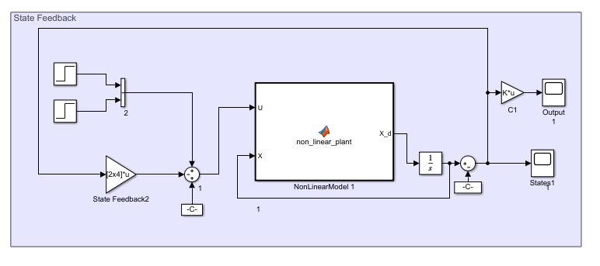
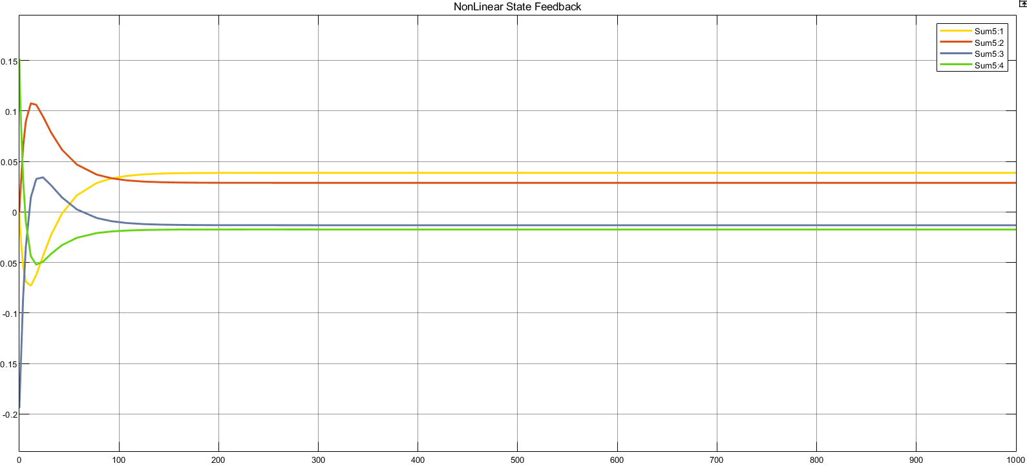
4- Simulation of non-linear system with state feed back controller
The state diagram of the system with the step input and the initial conditions will be stable after a short time, which is a desirable result.

Slide 29
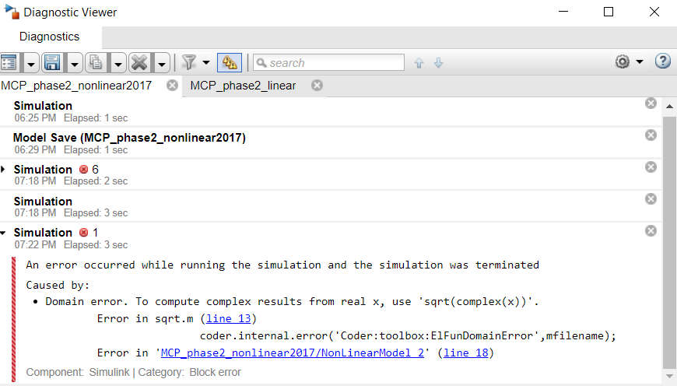
5- Unstability of nonlinear system with state feedback
Nonlinear system is stable if we considered the initial conditions of the system around the equilibrium points.
For example, if we consider the initial conditions equal to zero, we encounter an error due to the negative output values in the simulation.

Slide 30
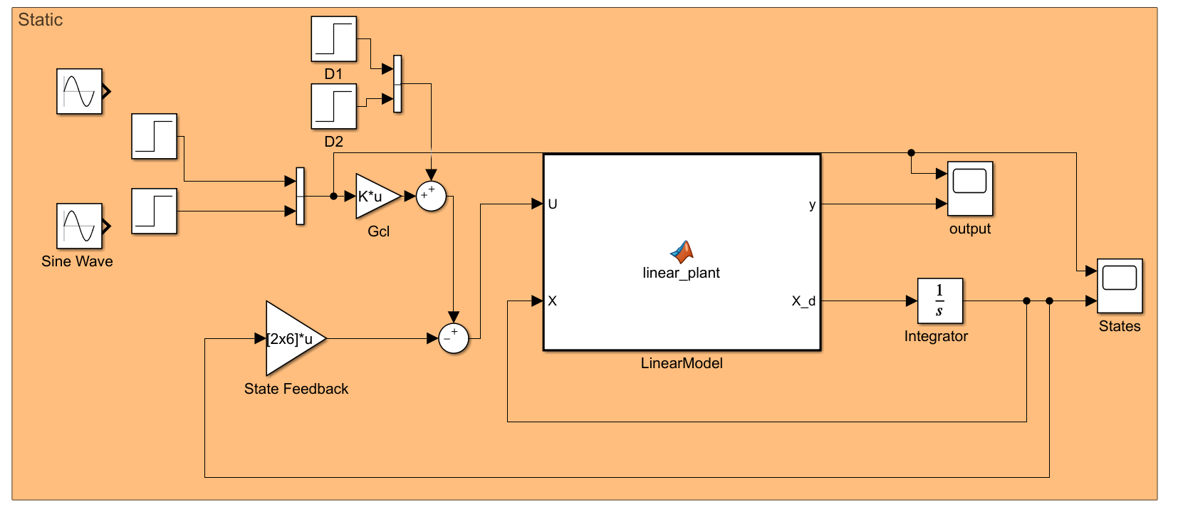
6-1 Static pre-compensator(linear system)

Slide 31
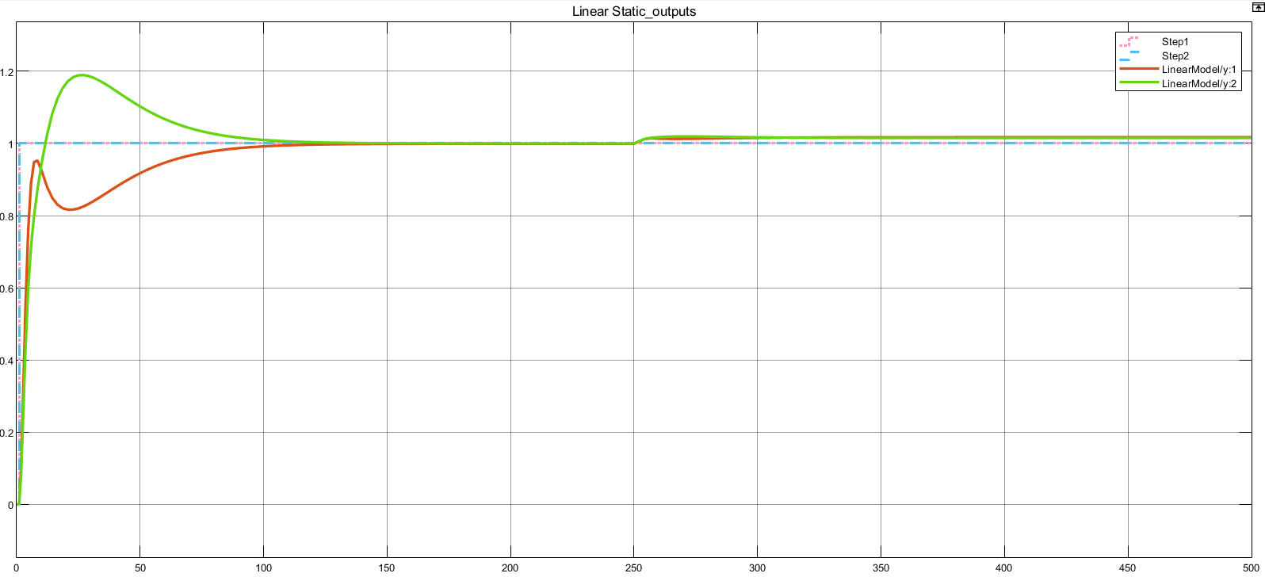
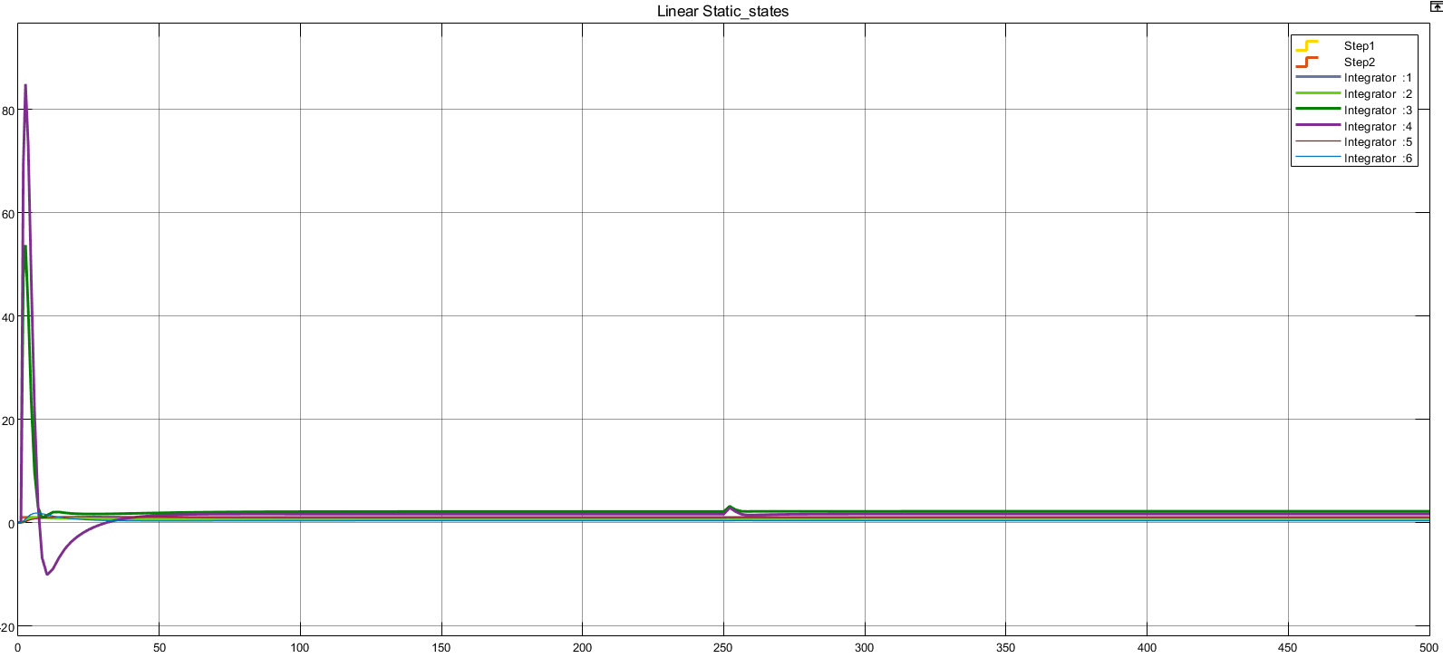
Step input and constant disturbance

Slide 32
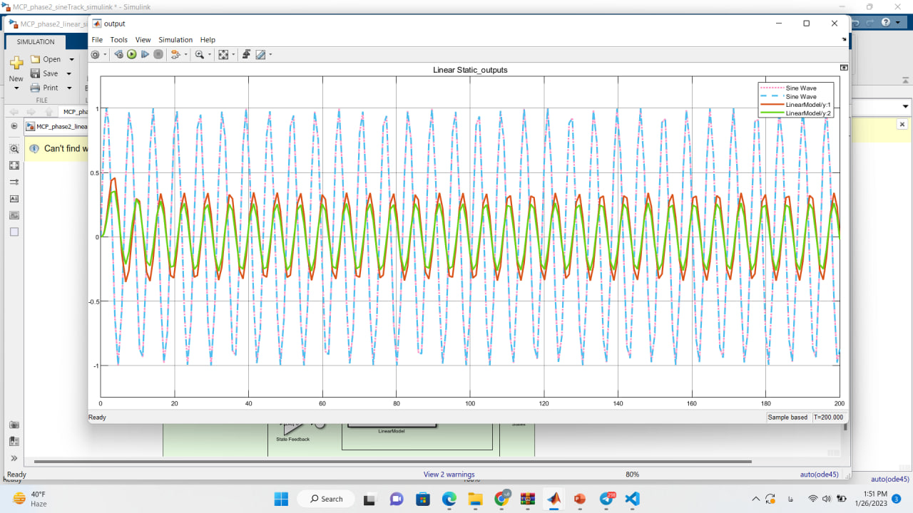
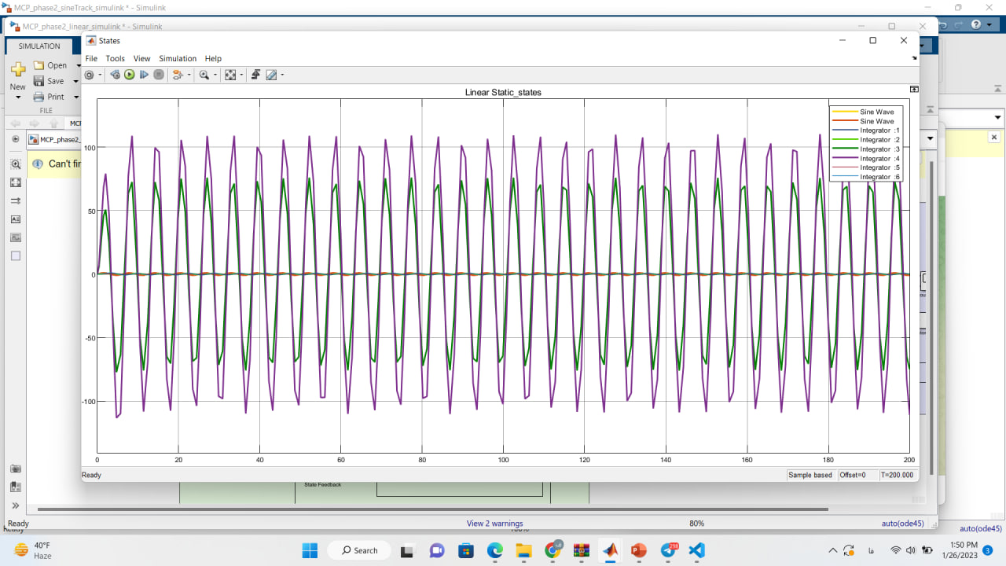
Sine input and constant disturbance

Slide 33
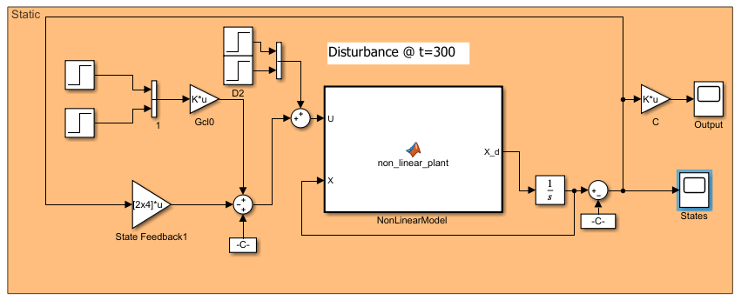
6-2 Static pre-compensator(nonlinear system)

Slide 34
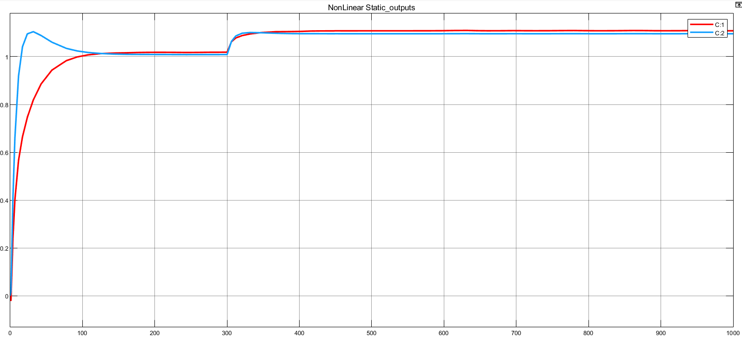
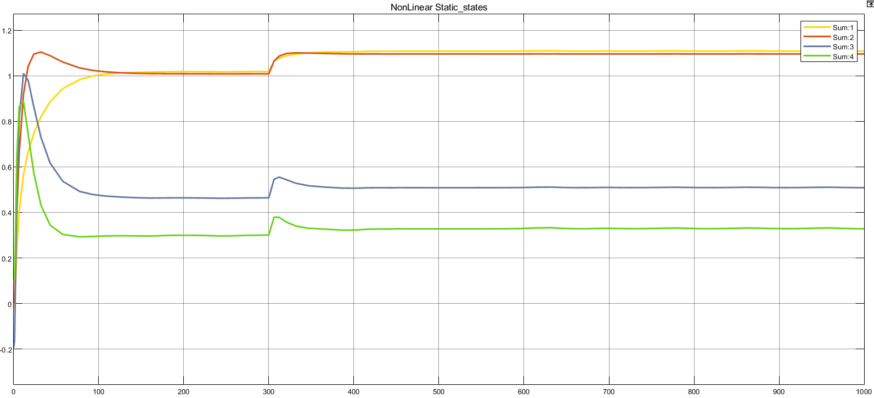
Step input and constant disturbance(with value 4 and at time 300)

Slide 35
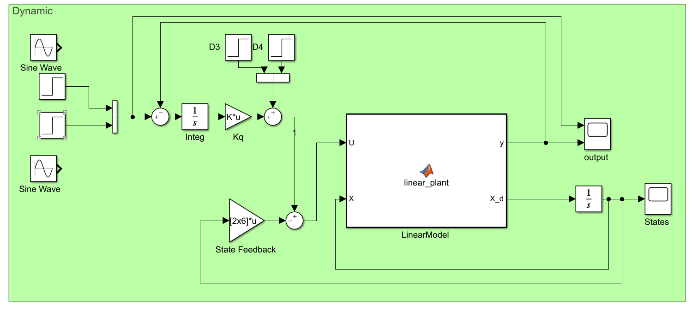
7-1 Dynamic pre-compensator(linear system)

Slide 36
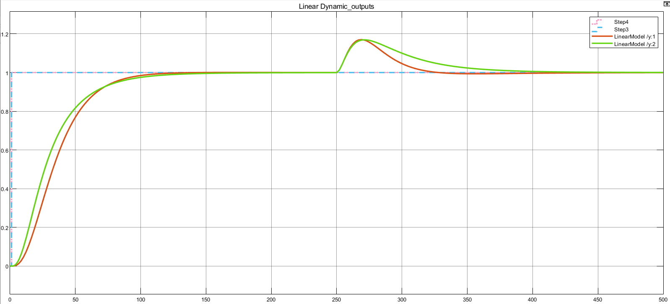
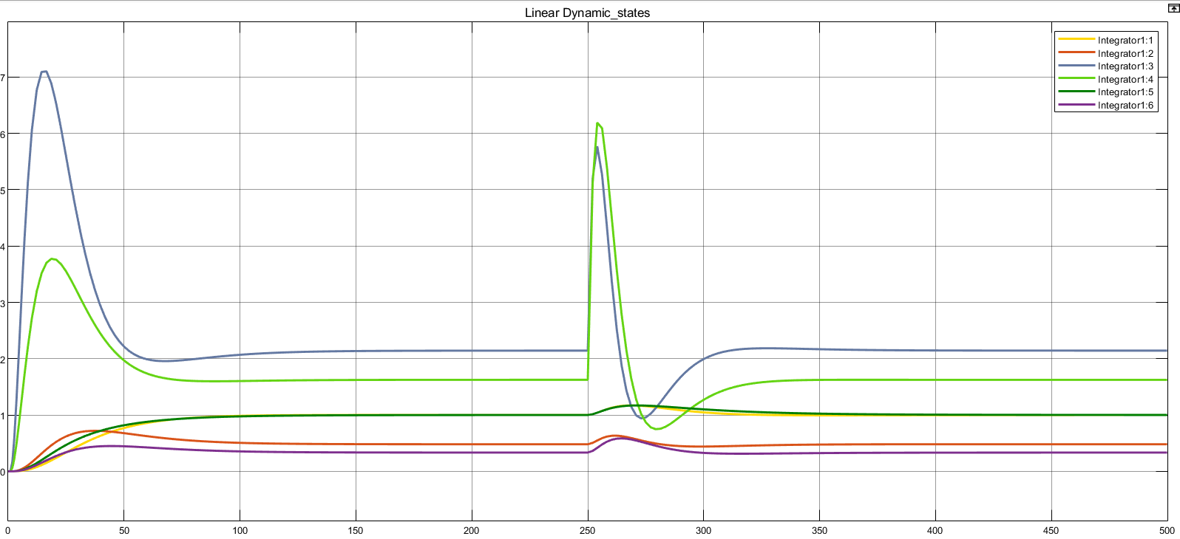
Step input and constant disturbance(with value 5 and at time 250)

Slide 37
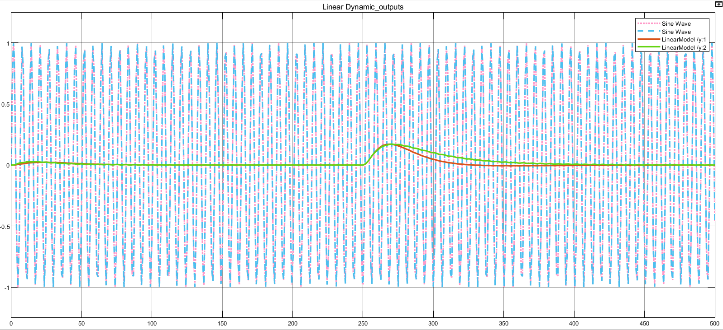
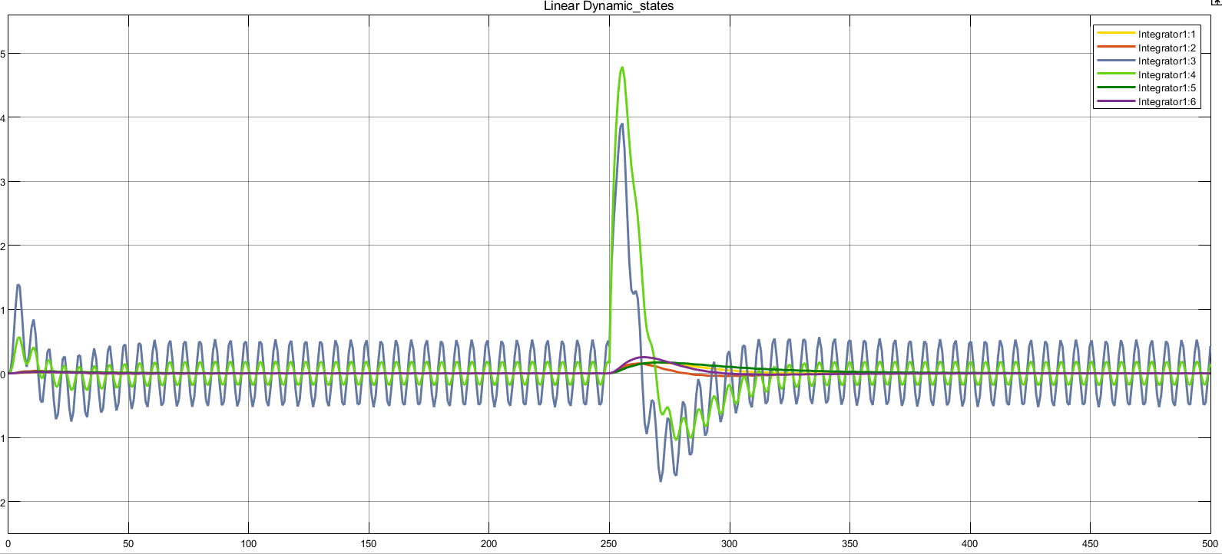
Sine input and constant disturbance

Slide 38
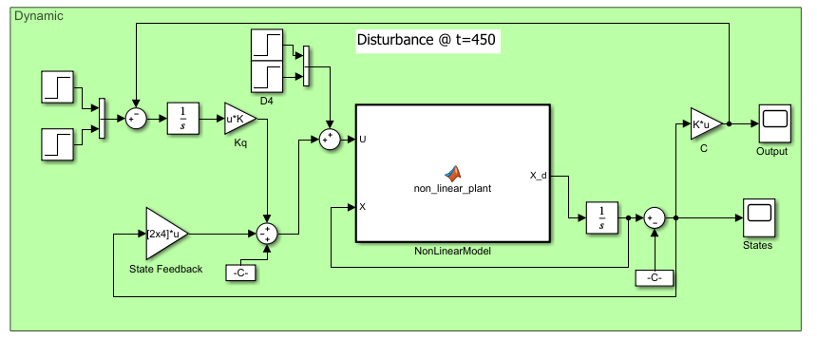
7-2 Dynamic pre-compensator(nonlinear system)

Slide 39
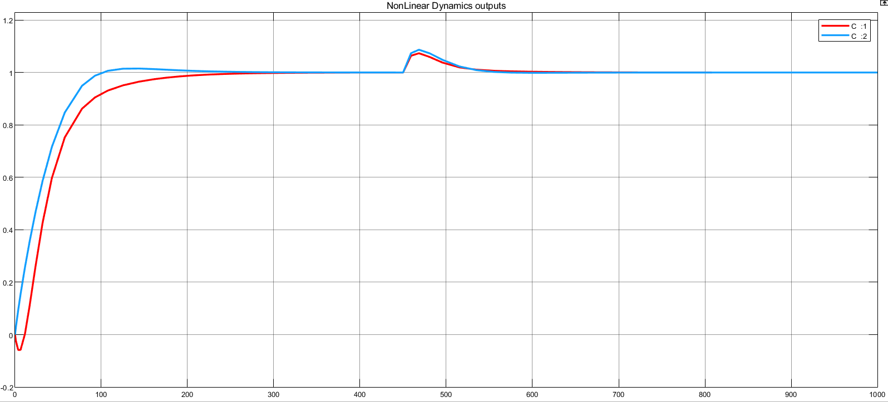
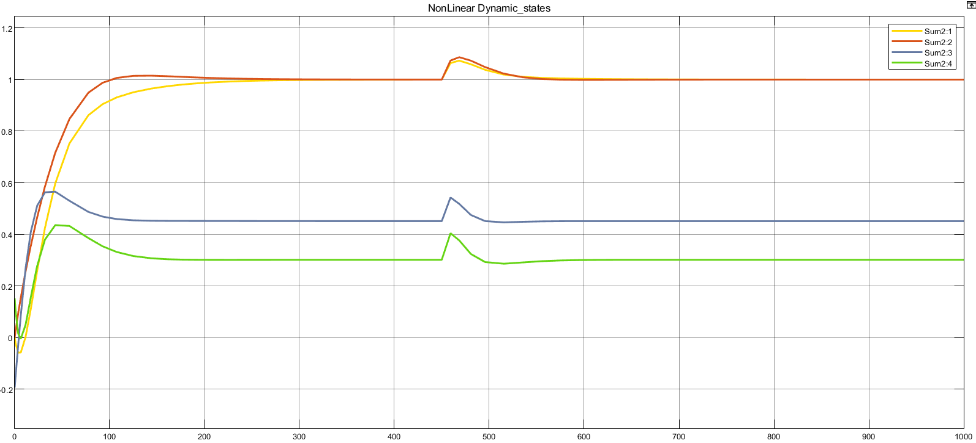
Step input and constant disturbance(with value 4 and at time 450)

Slide 40
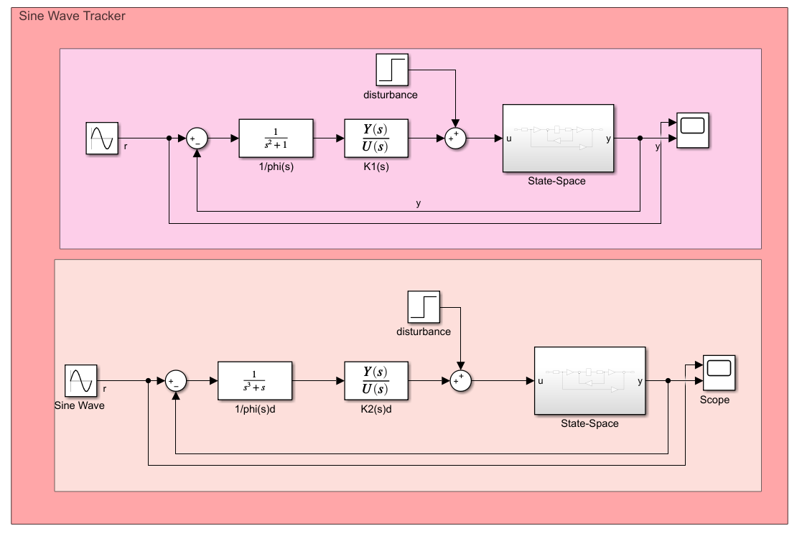
8 Simulation of pre-compensator tracking sine signal

Slide 41



Slide 42
Phase 3

Slide 43
Index
Full rank observer
Reduced rank observer
Use estimated states for feedback controller
Check all type of stability for system
Design a linear optimal control systems and simulation on system

Slide 44


1 Full rank observer

Slide 45


2 Reduced rank observer

Slide 46


4-1 linear static pre-compensator with full rank observer

Slide 47


4-2 linear Dynamic pre-compensator with full rank observer

Slide 48


4-3 None linear dynamic pre-compensator with full rank observer

Slide 49


4-4 linear static pre-compensator with reduced rank observer

Slide 50


4-5 linear dynamic pre-compensator with reduced rank observer

Slide 51


4-6 None linear dynamic pre-compensator with reduced rank observer

Slide 52


5 Check all type of stability for system
All the eigenvalues of the matrix A of the system are strictly negative, so the system is internally stable (asymptotically stable) .
It has no zero eigenvalue, it is not boundary stable.
Also, according to the theorem, since the system is internally stable, it is also BIBO stable.
With second theorem of Lyapunov:

Slide 53



6-1 Design a linear optimal control systems and simulation on linear system

Slide 54


6-2 Design a linear optimal control systems and simulation on none linear system

Slide 55
Conclusion
The system we are considering is a four-tank system, and its main issue is controlling the liquid level and regulating the flow between the tanks.
The linear model of this system is grade 6 and has two inputs and two outputs.
internal stability and BIBO stability
Controllable and Observable
Design a state feedback control and then static and dynamic pre-compensators and simulate and Comparison of linearized and non-linear system is done.
The dynamic pre-compensator is much more resistant to disturbance than the static pre-compensator
In the sinusoidal signal tracking section, we found that by adding the integral term of the controller, the sinusoidal signal can be tracked well.
We found that the full order observer has less error than reduced rank observer.
We were able to follow the step reference input signal using static and dynamic observers and pre-compensators.
We increase the speed of the system with an optimal controller (LQR) and simulate and compare the result in linearized and non-linearized systems.

Slide 56
References
[1] Wael A. Altabey, Model Optimal Control of the Four Tank System, International Journal of Systems Science and Applied Mathematics. Volume 1, Issue 4, November 2016 , pp. 30-41. doi: 10.11648/j.ijssam.20160104.11
[2] J. Jayaprakash and M. E. Hari Kumar, "State variable analysis of four tank system," 2014 International Conference on Green Computing Communication and Electrical Engineering (ICGCCEE), 2014, pp. 1-8, doi: 10.1109/ICGCCEE.2014.6922341.

Slide 57
THANKS!

